Slide 1
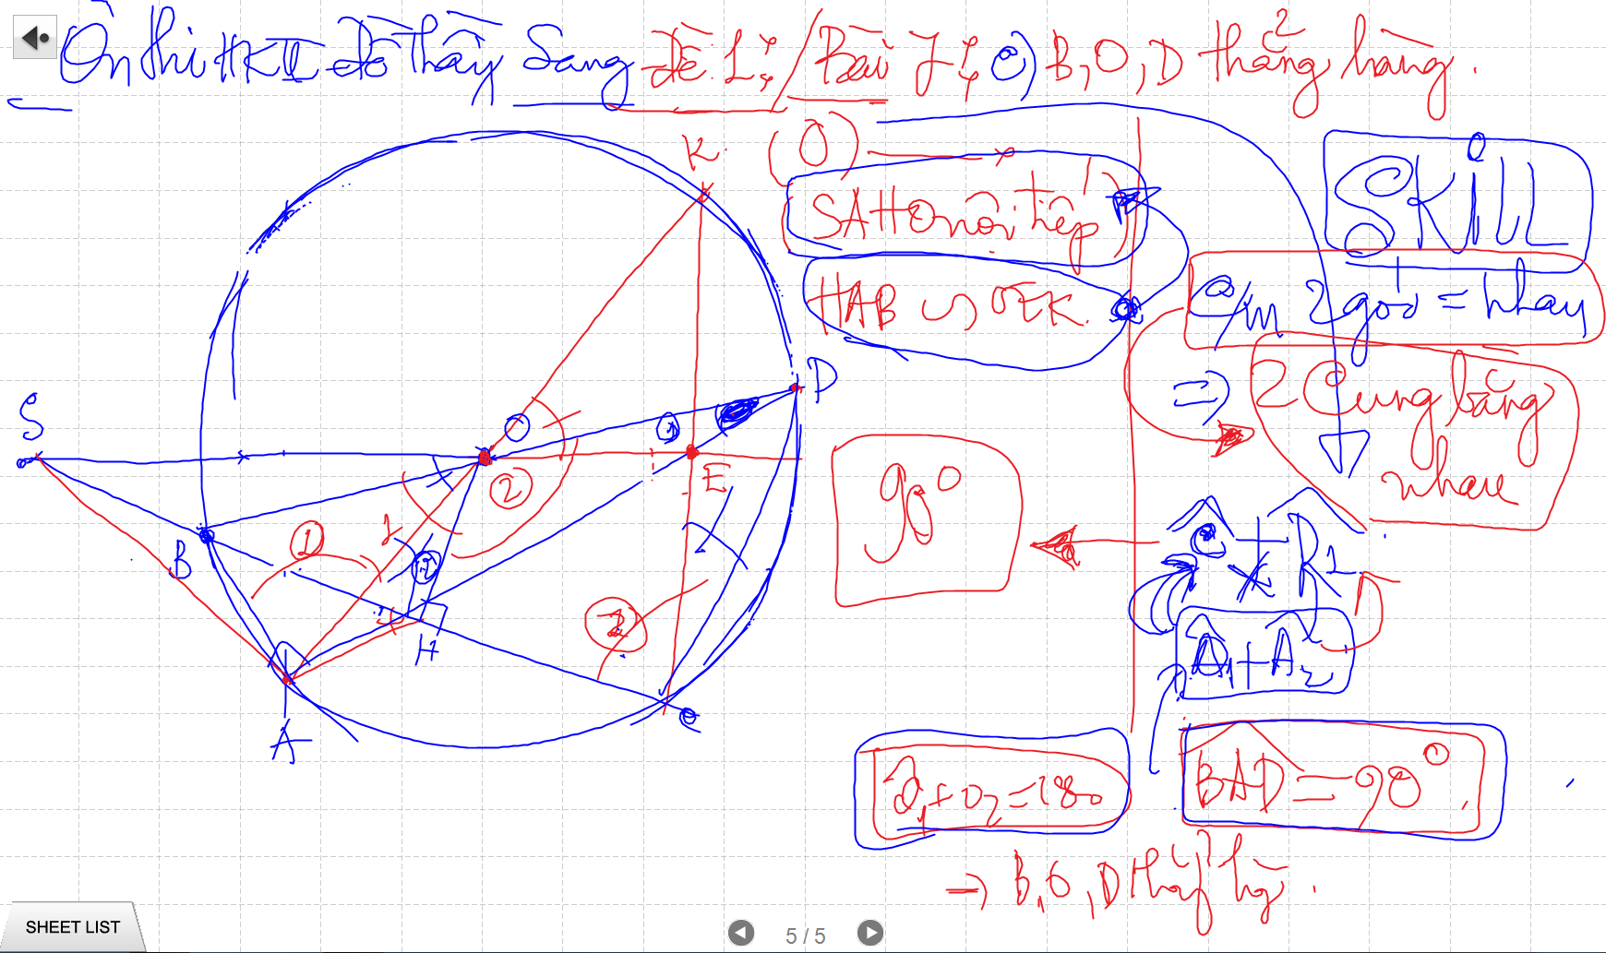
CM Goc bang CUNG: 2 goc chan cung mot cung, 2 goc chan 2 cung bang nhau,

Slide 2
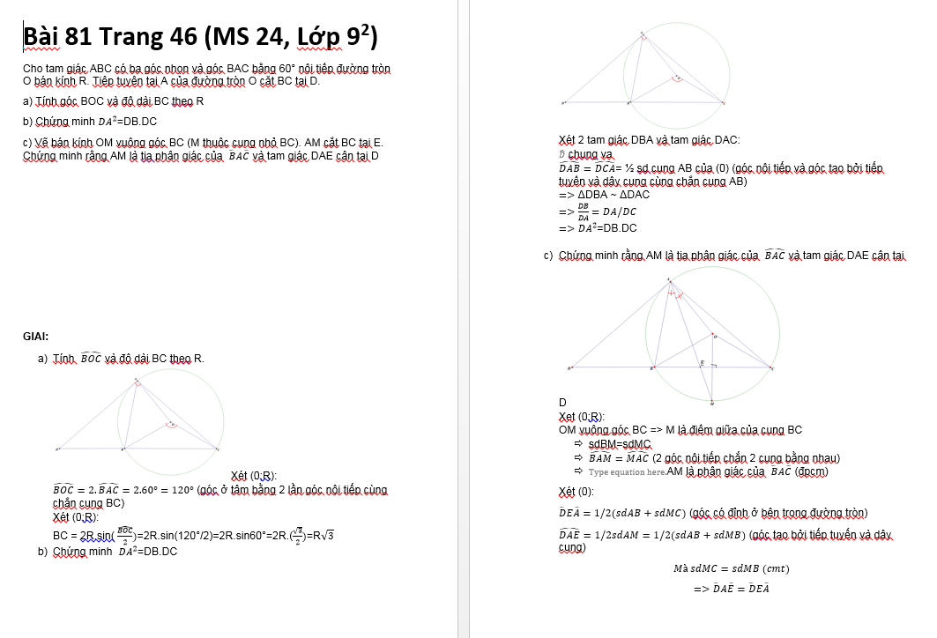
CM Goc bang CUNG: 2 goc chan cung mot cung, 2 goc chan 2 cung bang nhau,

Slide 3
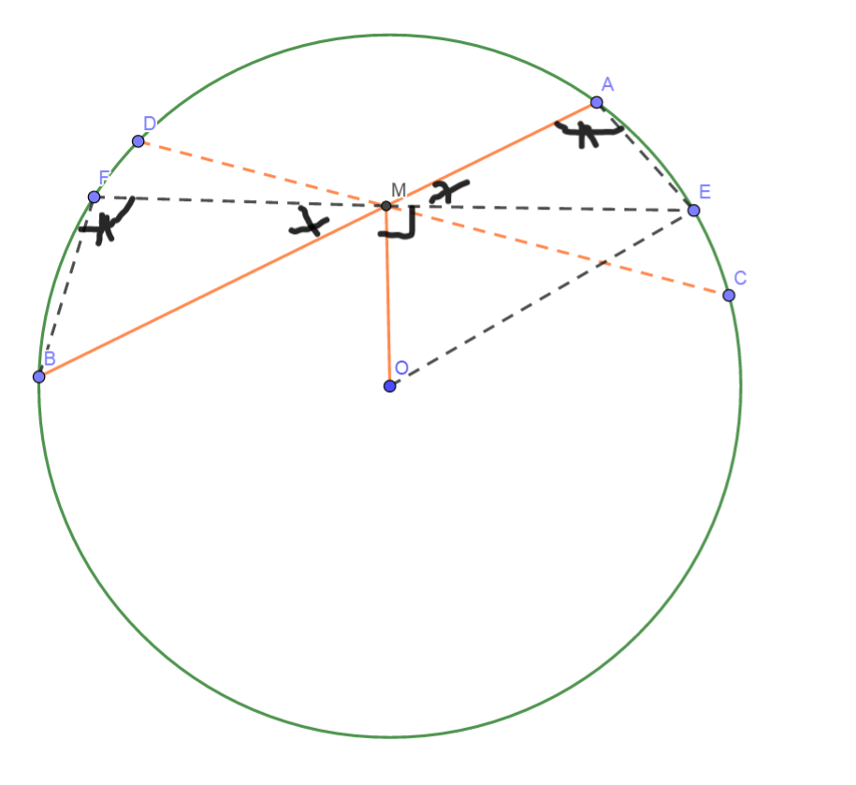
Phuong Tich cua mot diem nam ben trong duong tron
MA.MB=R²-OM²
He qua:
MA.MB=MC.MD=R²-OM²

Slide 4
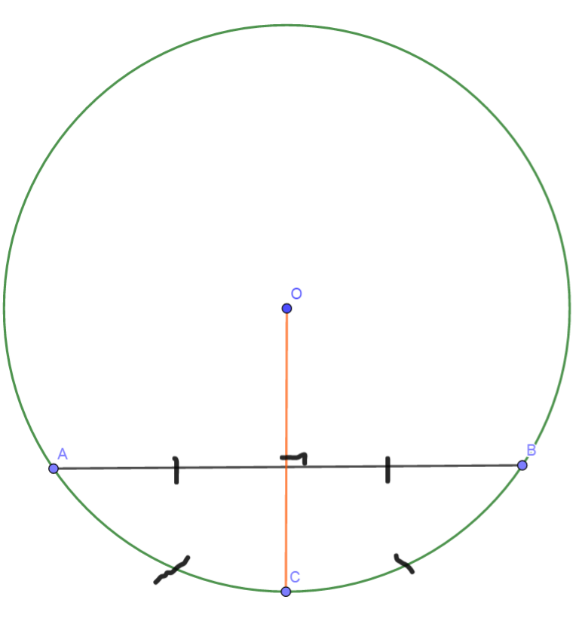
Diem chinh giua cua cung chia cung thanh 2 cung bang nhau
Duong kinh vuong goc voi day cung => di qua diem giua cua cung
Duong kinh di qua diem giua cua cung thi vuong goc voi day cung do

Slide 5
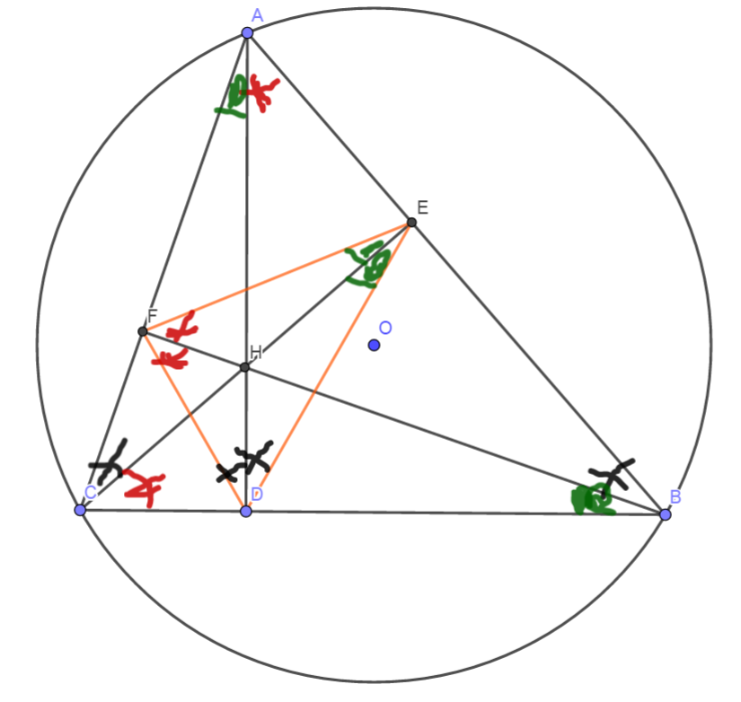
Tinh chat chan 3 duong cao
Chan 3 duong cao tao thanh tam giac DEF
3 duong cao cua tam giac ABC cung la 3 duong phan giac cua tam giac chan duong cao (DEF)

Slide 6
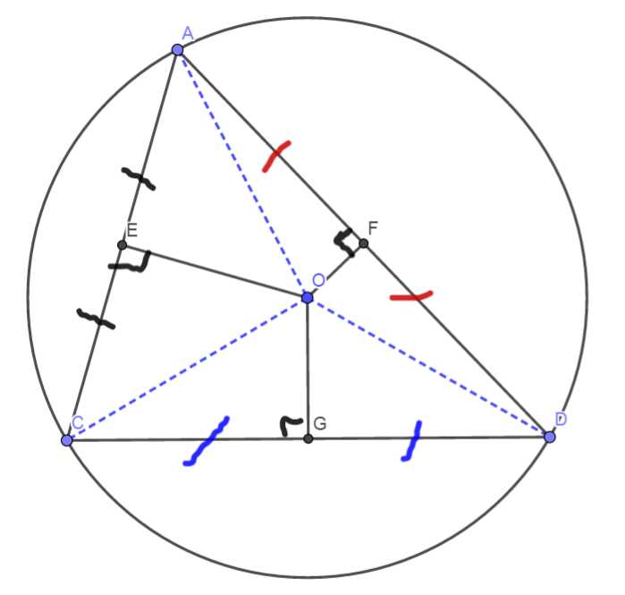
3 duong trung truc dong qui, la tam cua duong tron ngoai tiep tam giac
Giao diem cua 3 duong phan giac la tam duong trong noi tiep tam giac

